Slide 1
IMAGE SEGMENTATION
USING MATLAB

Slide 2
IMAGE SEGMENTATION
Image segmentation is the process of partitioning a digital image into multiple image segments, also known as image regions or image objects (sets of pixels).
The goal of segmentation is to simplify and/or change the representation of an image into something that is more meaningful and easier to analyze.Image segmentation is a pivotal task in the field of computer vision and image processing,
Accurate and efficient image segmentation is essential for extracting meaningful information from images, enabling machines to understand and interpret visual data.
Through this review, we will shed light on the state of the art in image segmentation within the MATLAB environment,

Slide 3
An image is a two-dimensional matrix consisting of rows and columns; each element within the matrix is considered a pixel . In a digital image, pixels are the smallest unit that can be controlled and manipulated.
Dividing or segmenting an image makes something vague easier to analyse .
Image segmentation can be divided into three types:
threshold-based
edge detection
Region based segmentation
TYPES OF IMAGESEGMENTATION

Slide 4
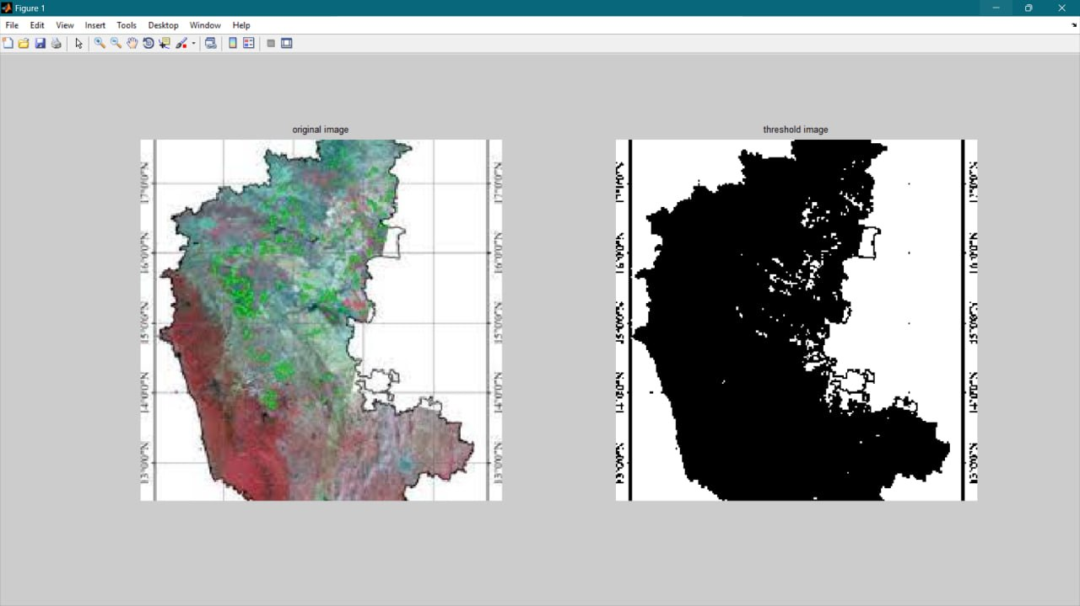
THRESHOLD-BASED SEGMENTATION
An image is a two-dimensional matrix consisting of rows and columns; each element within the matrix is considered a pixel . In a digital image, pixels are the smallest unit that can be controlled and manipulated.
Threshold-based segmentation method is used to make binary images from originals. This is done by comparing pixels to a specific threshold value—pixels greater than this value will be assigned 1 (black); pixels less than or equal to this value will be assigned 0 (white).

Slide 5
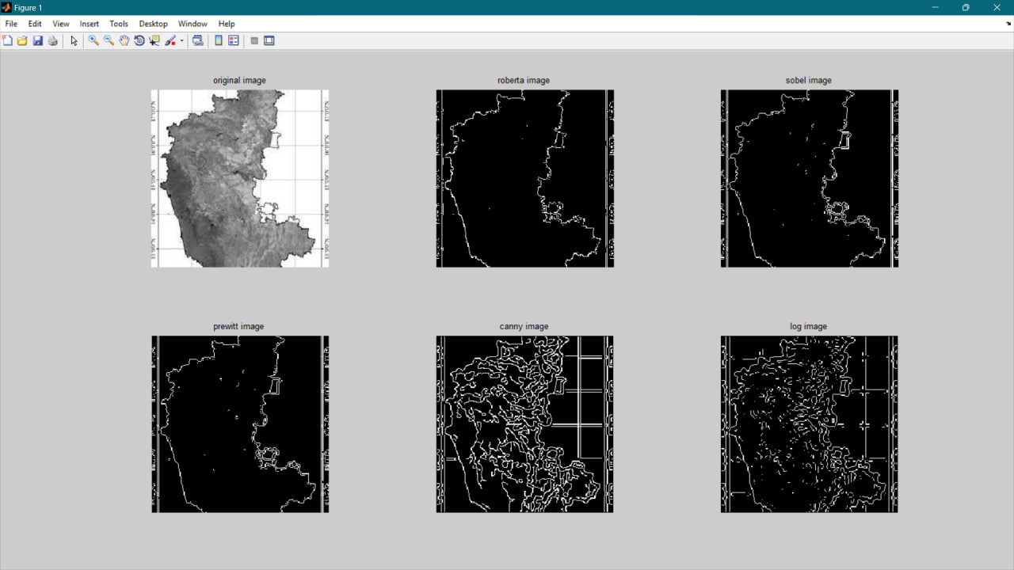
EDGE -BASED SEGMENTATION
This method is used to determine the details of objects by using intensity-level (grayscale) detection. Edge detection is one of the most common strategies used to analyse images. The edge method uses the difference between colours to determine the details of the edges. These details appear as white lines on a black background. There are several different methods used to filter images, such as :
• Sobel filter
• Prewitt filter
• Roberts filter
• Log filter
• Zero-cross filter

Slide 6
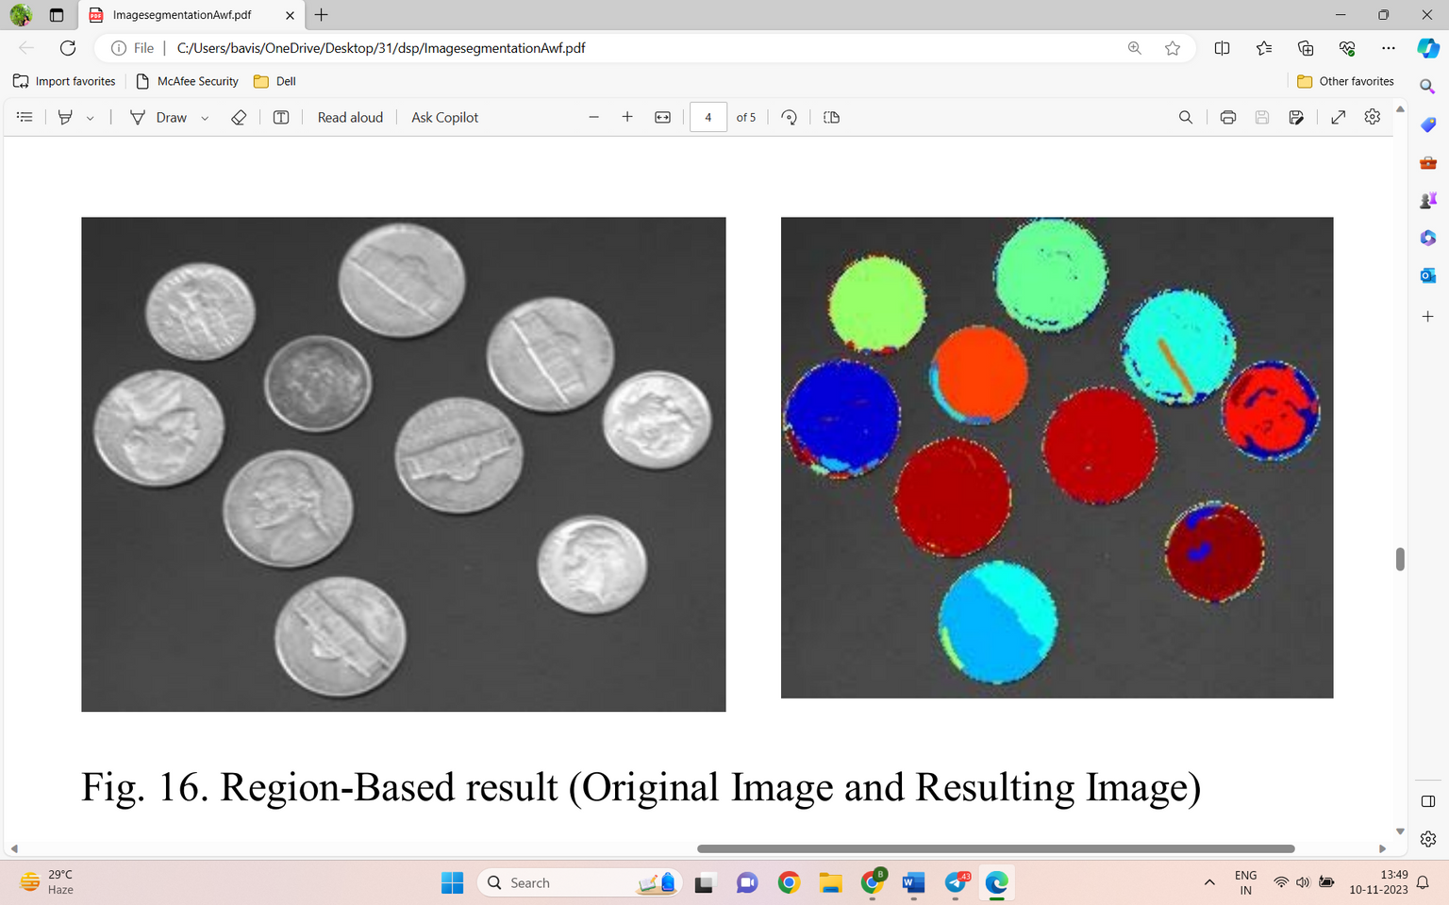
REGION-BASED SEGMENTATION
In this segmentation, we grow regions by recursively including the neighboring pixels that are similar and connected to the seed pixel. We use similarity measures such as differences in gray levels for regions with homogeneous gray levels. We use connectivity to prevent connecting different parts of the image.

Slide 7
THANK
YOU

